Slide 1



General Assembly Meeting
10h – 12:30h
6 November 2014
ASBL: 874.358.592 | Square du Vieux Tilleul 1/4, 1050 Ixelles, Belgium

Slide 2
Agenda
Welcome by Jimmie Bradshaw
Welcome and Farewells to Members
  VOTE: Approval of minutes from the GM at 21 October 2014
Vice-President & Guest Access by Beckie Metelko
Treasurer Update by Alessandra Bertozzi
Membership Update by Trine Lauvsnes
Guest Speakers – NATO International Club
Bazaar Update by Emily Michnay
Opening Ceremony by Jimmie Bradshaw
Coffee Break (15 minutes)
Tombola Update by Carla Bucalossi Quatrini
Restaurant Update by Cristina Arvanitaki
Sponsorship & Event Update by Dionysia Leolei
Donation Ceremony by Jimmie Bradshaw
Any other Business and Closing by Jimmie Bradshaw

Slide 3
Welcome
Jimmie Bradshaw - President
Welcome
Approval of 21 October minutes

Slide 4
Welcome to Members
Jimmie Bradshaw - President
Belgium – ANR – Geert Van Hessche
The former Yugoslav Republic of Macedonia* - NR – Lidija Jovanoska
*Turkey recognizes the Republic of Macedonia by its constitutional name

Slide 5

Farewell to Members
Jimmie Bradshaw - President
Belgium – ANR – Yves Lecoq
Estonia – 2nd ANR – Teele Treu
The former Yugoslav Republic of Macedonia* - NR - Violeta Drakalska
*Turkey recognizes the Republic of Macedonia by its constitutional name

Slide 6
Farewell to Board Member
Jimmie Bradshaw - President
Tuija Kuusisto (Finland), Assistant Charity Coordinator

Slide 7
Invitations & Passes
Guest Coordinator – Beckie Metelko
Please inspect your passes to make sure everything is correct.
I will be available during the coffee break and following the meeting to make any corrections.
Guest Cards /- Passes
distributed TODAY

Slide 8
REMINDERS
NORMAL NATO SIGN-IN PRIVILEGES ARE SUSPENDED DURING THE BAZAAR WEEKEND
PRESENT PROPER ID WITH PASS
REPORT LOST PASSES IMMEDIATELY
SHARE THIS INFORMATION WITH YOUR GUESTS AND HELPERS ☺

Slide 9
Invitations & Passes
Guest Coordinator – Beckie Metelko
Thank you for your patience and understanding during this process. I have enjoyed working with each and everyone of you and look forward to seeing you at the Bazaar

Slide 10
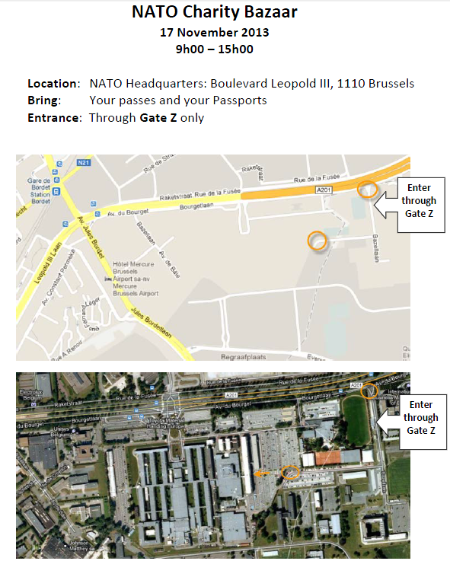
File available in
Members Only Area
FILE NAME:
Entrance-through-Z-
Gate Map-2013.pdf

Slide 11



Treasurer’s Report
Alessandra Foresti Bertozzi - Treasurer
Treasurer update
How to make the payment of funds into the NCB account
Notes:
11
11
11
11

Slide 12


Treasurer Update
Alessandra Foresti - Treasurer
TOTAL INCOME 2014
20.967 EUROS
On 05 November 2014
- Sponsors 13.132 €
- Bake Sales 5.179 €
- Bank premium 17 €
- Small x BIG 194 €
- Fundraising events 2.445 €
Notes:
12
12
12
12
12

Slide 13

Transfer of funds
Alessandra Foresti Bertozzi - Treasurer
Keep in mind
Notes:
13
13
13
13

Slide 14








Payment of funds into the NCB account
Alessandra Foresti - Treasurer
Keep in mind: 3 keys to success
Notes:
14
14
14
14

Slide 15


Transfer of funds
Alessandra Foresti Bertozzi - Treasurer
I M P O R T A N T
BMP BELGIO:
IBAN BE69 6434 0149 2878 - BIC BMPBBEBB
- Include in the communication section of your transfer the message:
Contribution to the 2014 NCB + “Nation’s Name”.
Notes:
15
15
15
15

Slide 16

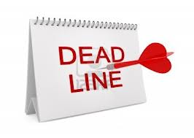


Keep in mind
Alessandra Foresti Bertozzi - Treasurer
YOUR GOAL IS :
Any transfer should be completed by:
Tuesday, 4 Dec. 2014
Notes:
16
16
16
16
16

Slide 17
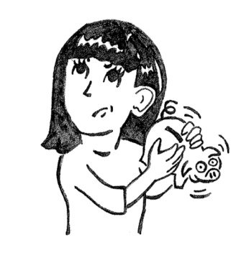
Treasurer’s Report
Alessandra Foresti Bertozzi - Treasurer
If you have any questions regarding this
“Transfer of funds”,
please don’t hesitate to contact the Treasurer Alessandra Foresti, via e-mail at
treasurer@natocharitybazaar.org
Notes:
17
17
17
17

Slide 18
Guest Speakers – NATO International Club
Carla Bucalossi Quatrini
Anne-Mie Habils

Slide 19
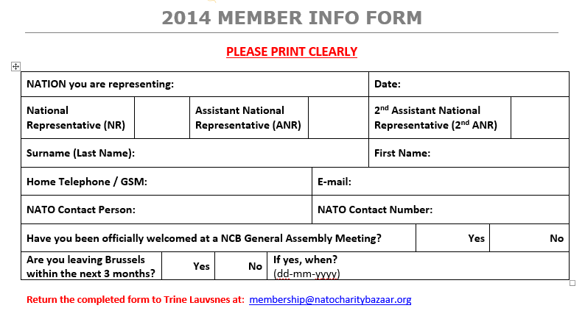
Membership Database
Trine Lauvsnes– Membership Coordinator membership@natocharitybazaar.org

Slide 20
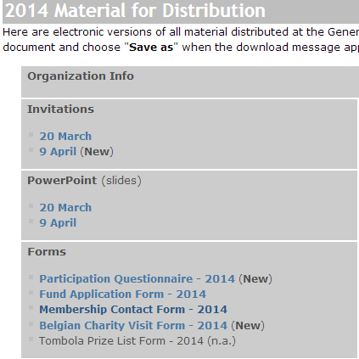
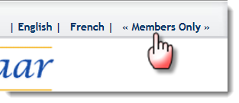
Membership Database
Trine Lauvsnes– Membership Coordinator membership@natocharitybazaar.org

Slide 21
FINAL Bazaar Instructions
Emily Michnay - Bazaar Coordinator
Final Instructions & Timelines
Entertainment
Thank you’s for NATO Staff
After Sale
Please read them carefully ☺

Slide 22
Final Instructions – Set-Up
When you arrive on Saturday, your National Stand space will be “marked” by the placement of the tables.
The Fire Inspector and the Bazaar Coordinator will do a walk through on Saturday beginning at 12h.

Slide 23
Final Instructions – Set-Up
Nations are allocated a number of tables. Your allotted tables will be placed in your assigned space.
You are responsible for assembling and dismantling the tables.
Bring a wrench or a socket wrench size: 13, 14 and 17 to assemble tables.

Slide 24
When you Arrive on Saturday
Your area will have:
Tables + Chairs
Name Plates ready to be displayed prominently
Two (2) white garbage bags
‘Clean Up Check List’ with the number of tables you were provided
Floor Plan in A4 + 2014 Tri-folds

Slide 25
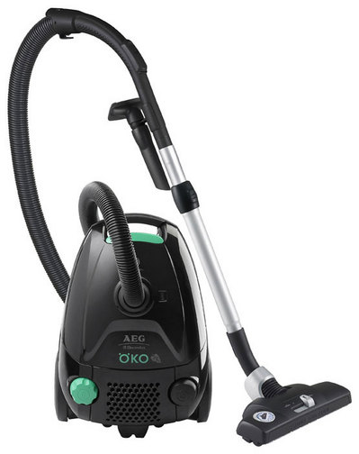
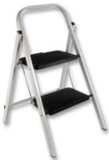
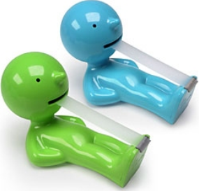
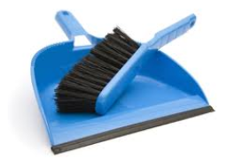
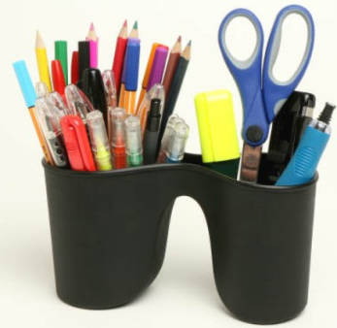
Supplies to bring
Extension Cord
Power strip
Broom and dustpan
Tape, pens, string
Small ladder
Rubbish container for your stand
Vacuum

Slide 26
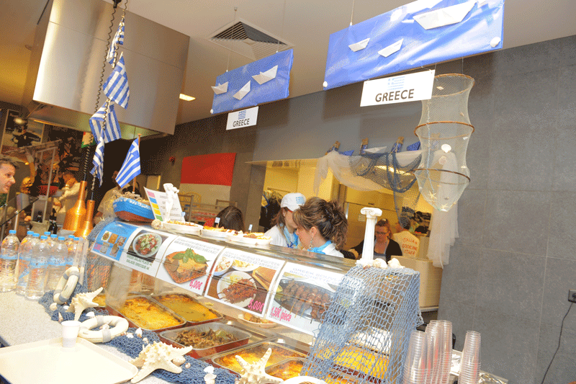
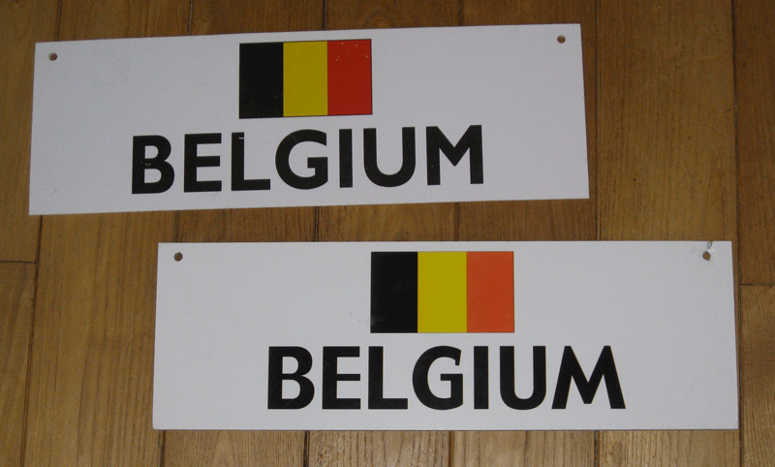
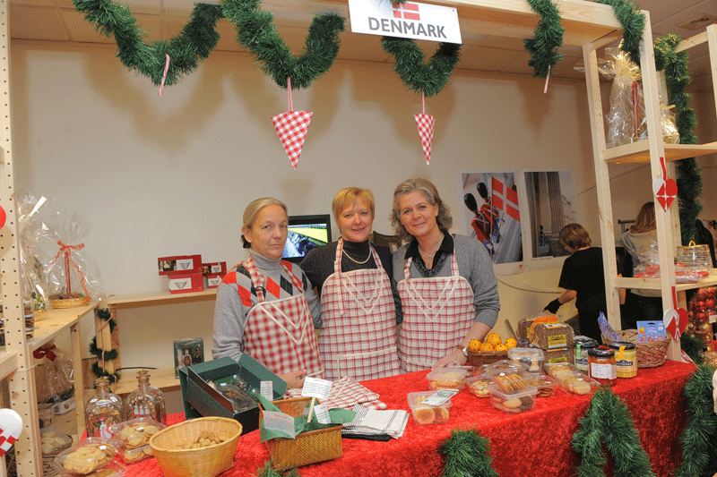
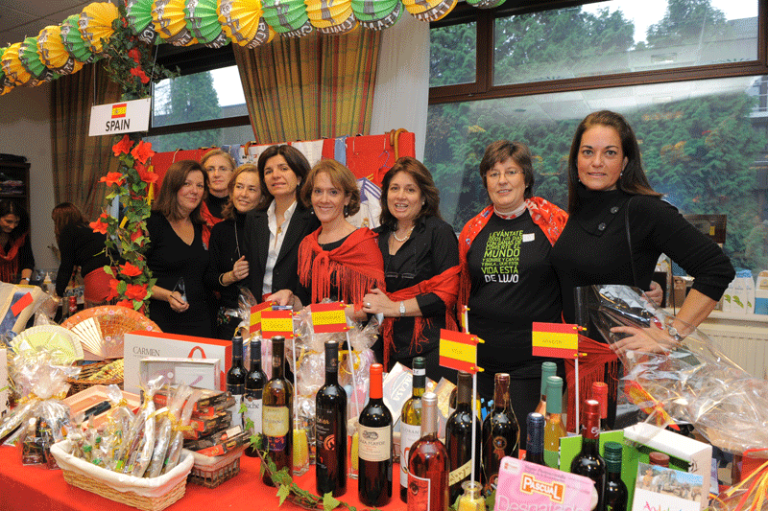
NAME PLATES
  Each nation will be provided a name plate showing the nations name and national flag. Please hang your name plate so that it is visible.
  NOTE: This is the ONLY item
  that can be hung from the ceiling

Slide 27
Final Instructions – Set-Up
Each nation may decide whether they wish to sell items on Saturday or not.
Each room/area will have a board member or board representative monitoring set-up procedures and assisting where necessary.

Slide 28
Final Instructions – During the Bazaar
Ensure you have change. The bank will not be open to make change.
NIC/NCB Information desk is in front of the Luns Theater
Keep the area clean. Take trash outside (put IN the bins, not around) as needed; don’t save it all until the end of the bazaar

Slide 29
Dealing with Trash
A Primer on disposing of waste before, during, and after the Bazaar

Slide 30
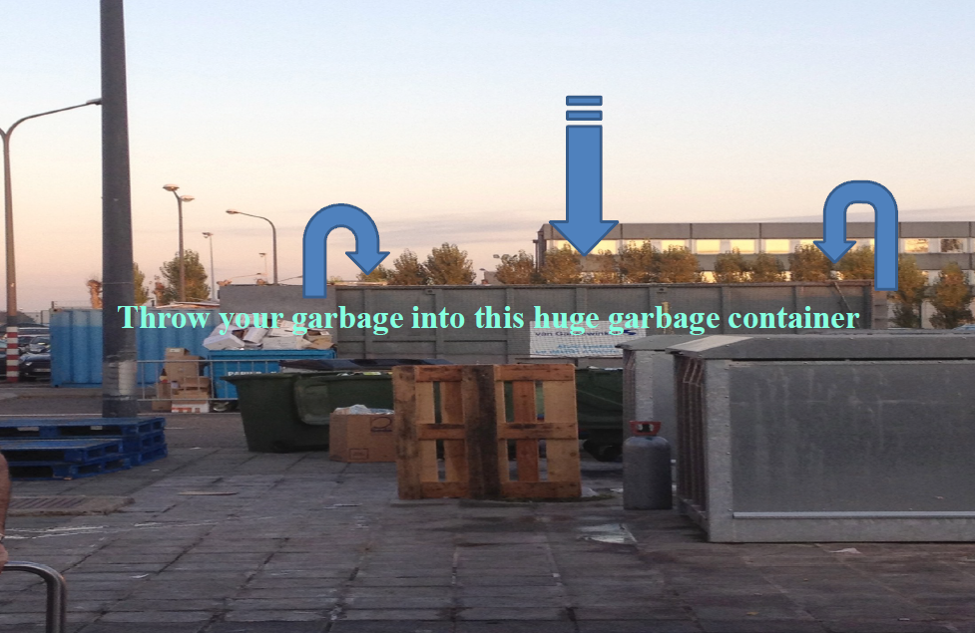

Slide 31
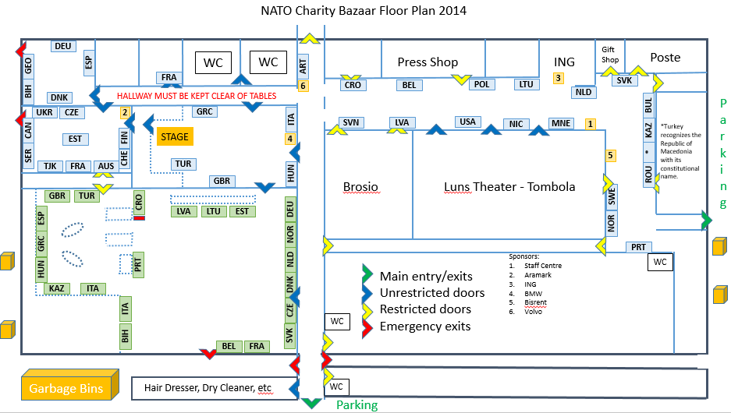
GARBAGE MANAGEMENT
Outside Trash Bins

Slide 32
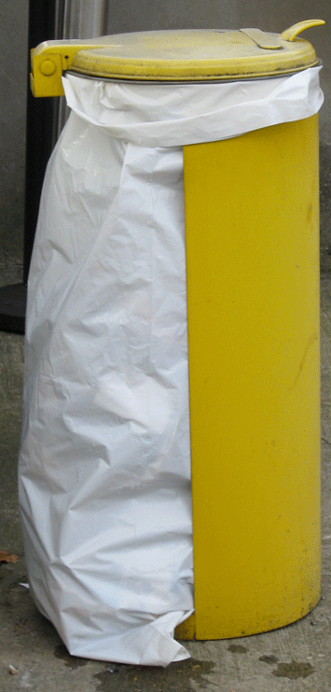
GARBAGE MANAGEMENT inside Bazaar
CLEAN UP:
We are responsible of the garbage bins closest to our stands.
Empty yellow garbage pails hourly – or before if needed. Replace the white bag with a new one.
Throw filled white garbage bags in appropriate bins/container ONLY (outside behind kitchen.

Slide 33
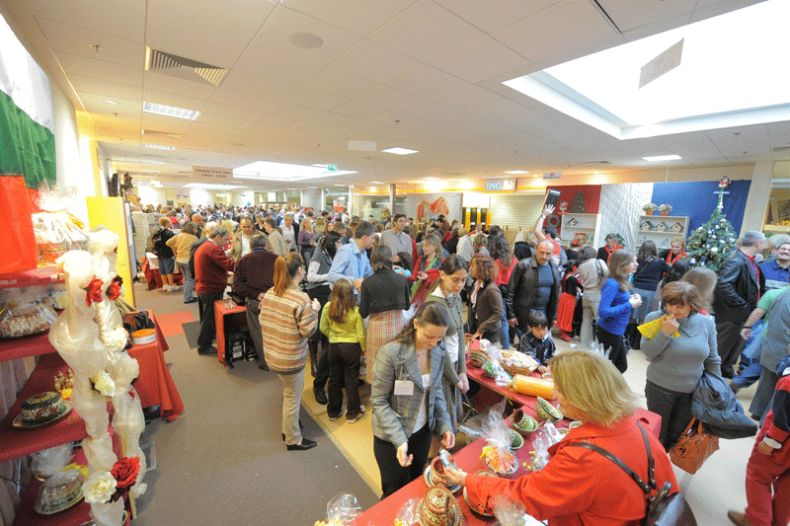
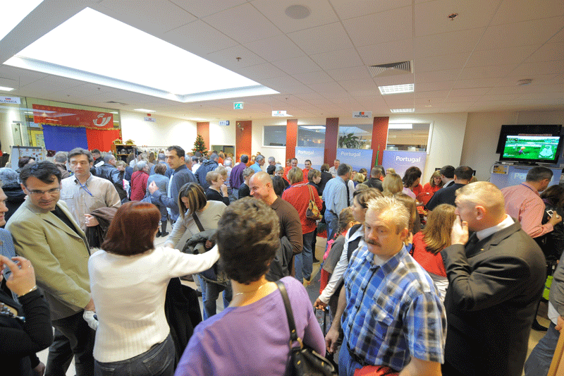
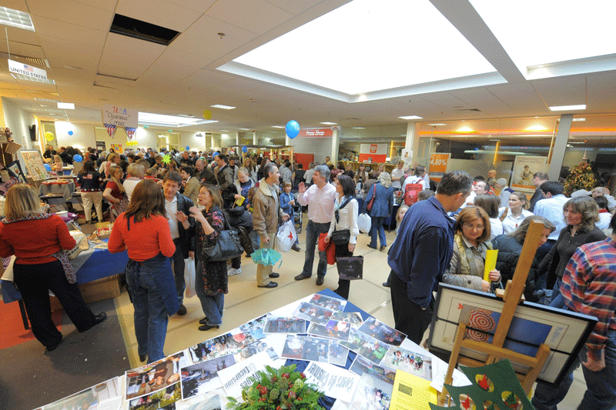
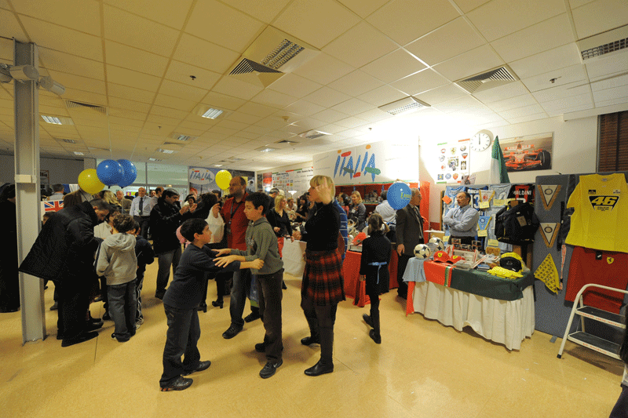
Keeping the Bazaar Clean
MONITOR TRASH – EMPTY OFTEN

Slide 34
Final Instructions – During the Bazaar
The NCB President & Vice-President will be escorting the patrons around the bazaar area starting in the restaurant area.
A board member or board representative will let you know when they are close to your stand. Please be ready to greet them and if you would like a group photo, have your volunteers ready.

Slide 35
Final Instructions – During the Bazaar
A board member or board representative will be in each area to assist.
In case of emergency (NATO security/fire needed immediately), please call x4000 from inside NATO or 02 707 4000.

Slide 36
Final Instructions – Do’s & Don’t’s
Food/drink is only allowed in the International Restaurant area.
You are still free to sell unopened or wrapped bottles/food from your National Stands.
Food & drink for immediate consumption cannot be sold at national stands.

Slide 37
Final Instructions – Do’s & Don’t’s
The whole area of the Bazaar is Non-Smoking. Ashtrays are provided outside the building at all regu­lar entrance points.
No food, drink or unaccompanied children will be allowed in the Luns Theatre where the Tombola will take place.

Slide 38
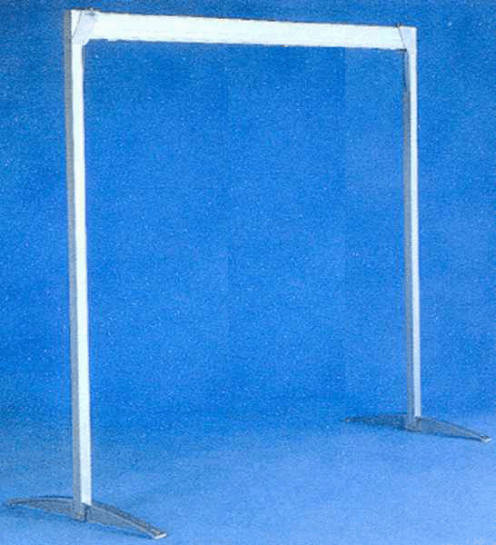
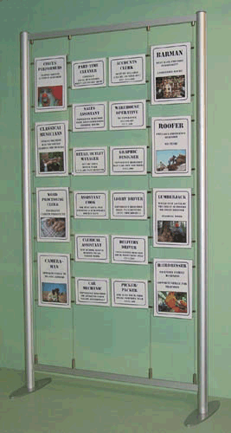
REMINDERS
No Material may be attached to
NATO walls or ceiling
ONLY freestanding frame or shelving are allowed

Slide 39
Final Instructions – Clean-Up
Clean-up checklists will be on your table. If you need a new one please see the NIC/NCB Information desk.

Slide 40
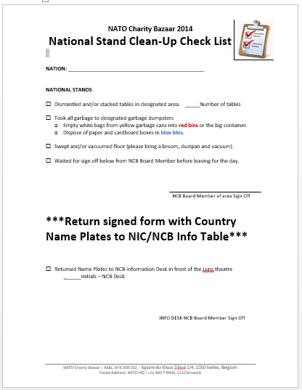

Slide 41
National Stand Clean-Up Checklist
Dismantled and/or stacked tables in designated area
Took all garbage to designated garbage dumpsters
Swept and/or vacuumed floor (please bring a broom, dustpan and vacuum).
Waited for sign off below from NCB Board Member before leaving for the day.
Returned Name Plates to NCB Information Desk in front of the Luns theatre

Slide 42
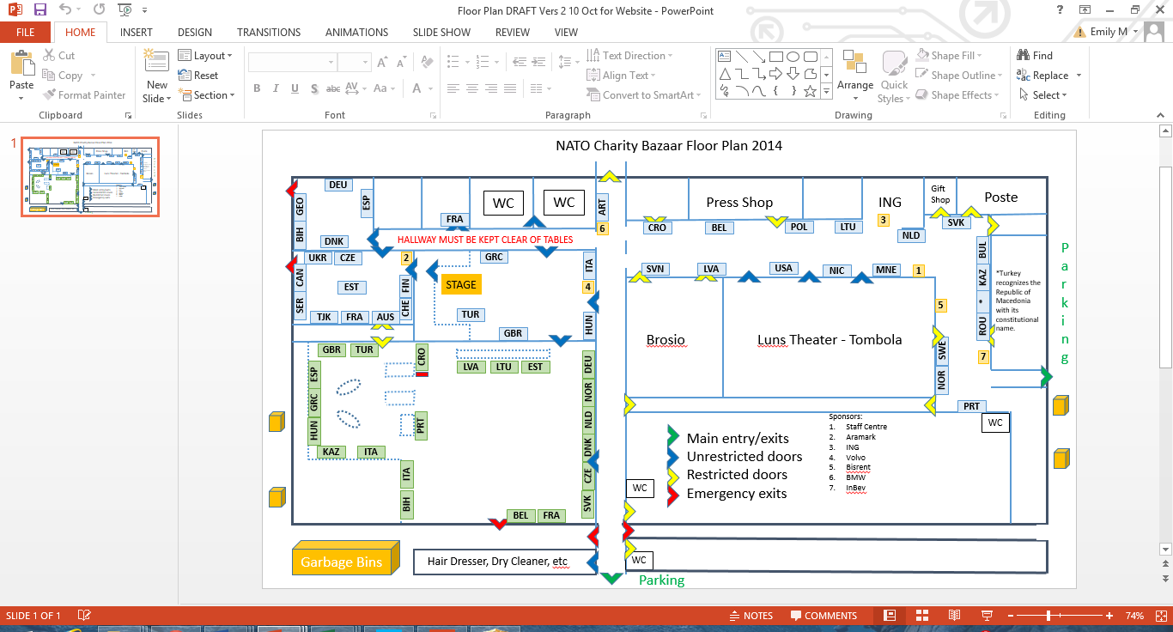
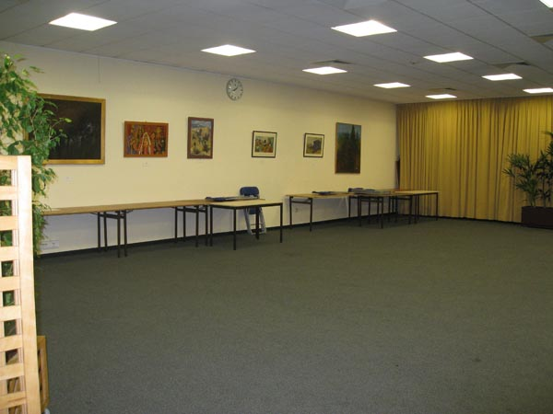
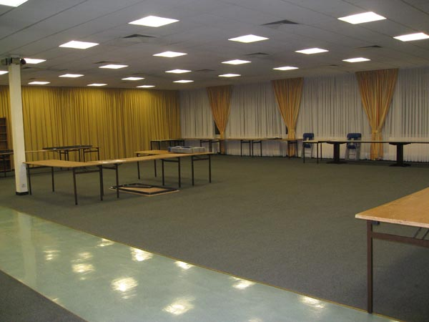
CLEAN UP
ALL TABLES need to be stacked unless they are permanent tables for the room.

Slide 43
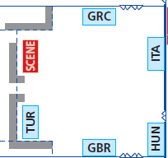
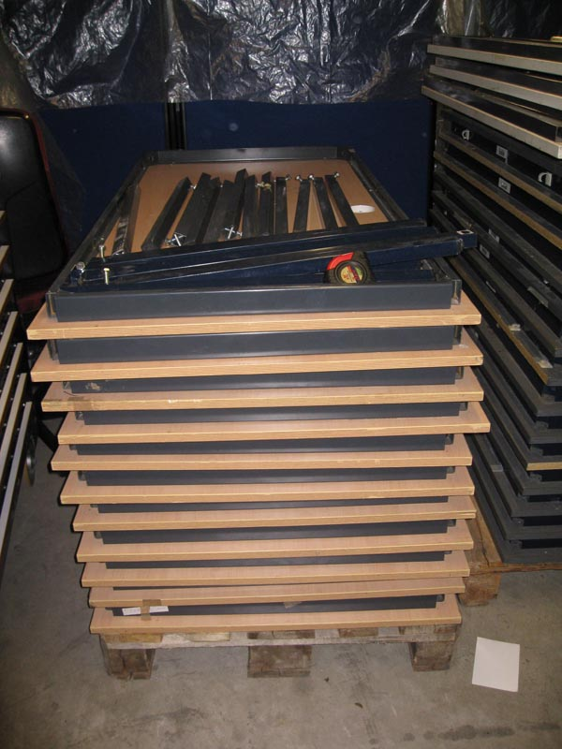
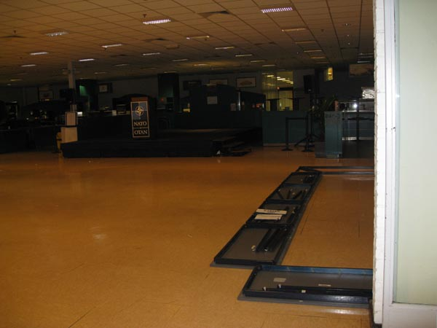
CLEAN UP
Legs need to be removed from the tables and stacked on pallets

Slide 44
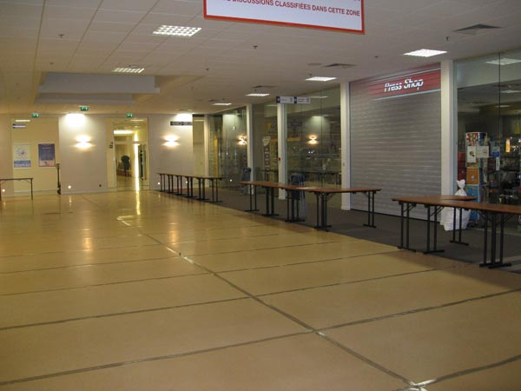
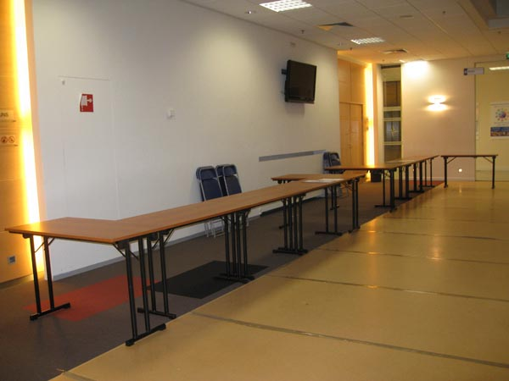
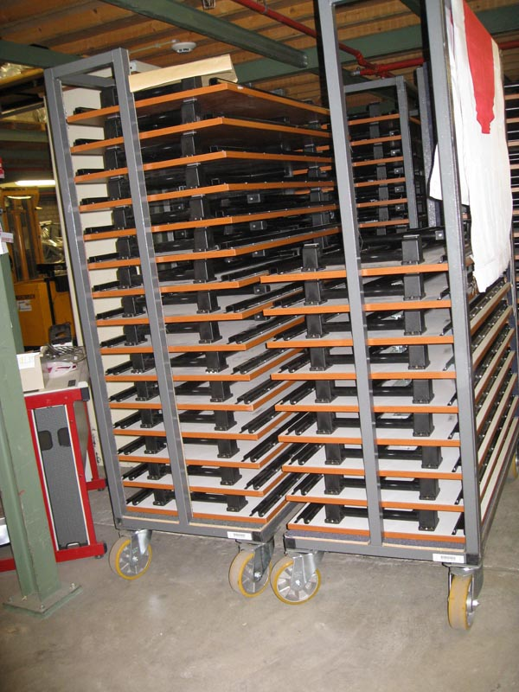
CLEAN UP
Tables
Tables need to be folded and placed on carts.

Slide 45
Final Instructions – Clean-Up
Once your clean-up checklist is signed off, bring that and your country plaque to the NIC/NCB Information Desk and turn it in to the board member there. Once this is complete, you may depart.

Slide 46
Final Instructions – Clean-Up
NATO is open for “business as usual” on Monday morning. Each is expected to leave the NATO premises in exactly the same state as we normally find it.
NATO Staff working overtime cannot depart until we do. Please find other venues in which to celebrate after 1700.

Slide 47
Communication
Phone numbers can be found on the last page of the final instructions.

Slide 48
Saturday Agenda
    8:00h - Set-up of National Stands starts with volunteers from each nation.
    9:00h-11:00h - Handing in of Tombola Prizes at Luns Theatre.
    11:00h - Opening Ceremony Rehearsal.
    11:30h-13:30h - Handing in of ALL tickets at Luns Theatre.
    12:00h - Walk through with Fire/Facilities
    13:00h - Closing of the Restaurant area.
    15:30h - Closing of the whole Bazaar area.

Slide 49
Sunday Agenda
    8:00h - Opening of the Bazaar area for SETUP ONLY
    9:15h - Photo session in the Cafeteria area
    Note! All NR + ANR in place no later than 9:10h.
    9:45h - Opening Ceremony on the Podium in the small
    Cafeteria.
    10:15h - Patrons preview of International Restaurant.
    11:00h - Patrons preview of National Stands
    13:00h - Tombola Ticket sales at the NIC booth ends
    14:00h - Tombola starts.
    16:00h - Return of signs and flags to the information desk.
    16:30h - Closing of the Bazaar.

Slide 50

Reminders
Emily Michnay - Bazaar Coordinator
    NO COMMERCIAL VENDORS
    Items offered by nations at the Bazaar must be presented on a non-commercial basis. That is, no commercial vendors are allowed to participate as part of a nation’s stall. (Article 7 of the Internal Regulations)
    ALL PROCEEDS GO TO CHARITY
    All proceeds (less legitimate overhead costs) must be transferred to the NATO Charity Bazaar ASBL Bank account. (Article 7 of the Internal Regulations)
    FINAL AUTHORITY
    The final authority for all aspects of the Bazaar rests with the President of the NATO Charity Bazaar ASBL in consultation with the appropriate NATO authorities.

Slide 51

NCB Info Table

Slide 52
Saturday 9:00-11:00am
- Handing in of Tombola Prizes

Slide 53
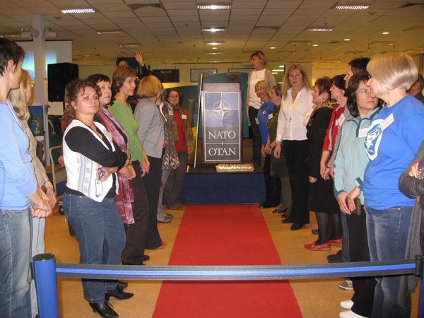
Saturday
11:00h Opening Ceremony rehearsal
Sunday
9:15h Group Photo
9:45h Opening Ceremony

Slide 54

SHARE THIS INFORMATION
WITH YOUR TEAM

Slide 55
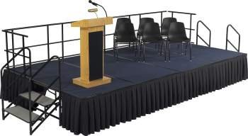
Entertainment
Provided by:
Estonia
Finland
Kazakhstan
Latvia
Romania
Slovenia
Turkey
Ukraine
UK
Schedule to be announced soon!

Slide 56
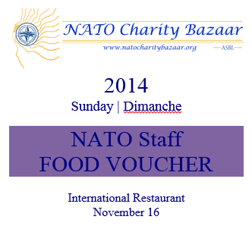


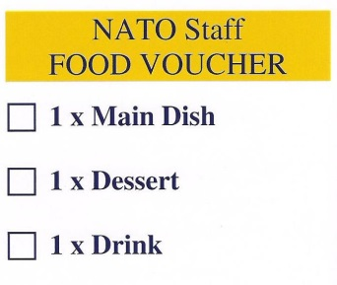
Thanking NATO Staff
#1
#2
    Thank You Gift
    1 Bottle per Nation
    DUE: 21 OCT GA Meeting
    If you have not provided your bottle, bring it to our ‘Info Desk’ Saturday, 15 November
Sign on the back for:
1 x Food (main dish),
1 x Dessert, 1 x Drink

Slide 57
Bazaar After Sale
Dates: Nov 24 – 28 | Monday - Friday
Time: 10:00 – 14:00
Location: Press Hall (ING Bank Area)
Participants: 5 nations per day
Each nation gets 2-3 tables
Everyone needs to be self sufficient

Slide 58
Bazaar After Sale
Sign Up Today (during break)
Schedule will also be at NIC/NCB info table at bazaar – may sign up on bazaar day.
Mon 24 Nov | Tues 25 Nov | Wed 26 Nov | Thu 27 Nov | Fri 28 Nov
1. 2. 3. 4. 5. | 1. 2. 3. 4. 5. | 1. 2. 3. 4. 5. | 1. 2. 3. 4. 5. | 1. 2. 3. 4. 5.
Each nation gets 2-3 tables
Everyone needs to be self sufficient

Slide 59
Opening Ceremony
Jimmie Bradshaw – President
09:00 Patrons and sponsors arrive and go to Cafeteria for
‘Patrons & Sponsor Welcome Coffee’ and Photo Session
09:10 Members arrive at stage area
09:15 Photos with Dignitaries and Members
09:45 Opening Ceremony
- Remarks
      NCB President, Jimmie Bradshaw
      NCB Honorary President, Lady Jan Harper
      Director, NATO Staff Center, Alun Morris
    - Roll Call of Participating Nations
    - Ribbon Cutting
The Bazaar is declared officially opened.
10:15 International Restaurant preview
11.15 National Stands preview

Slide 60
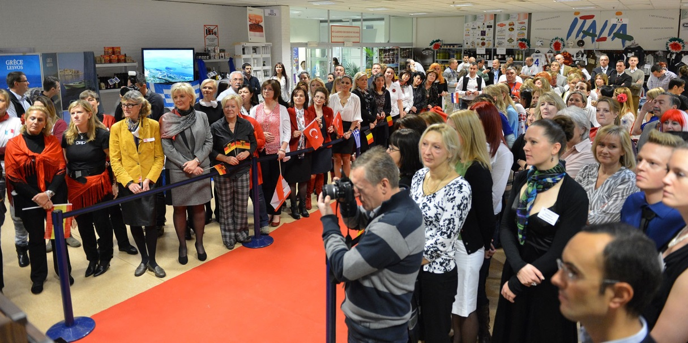
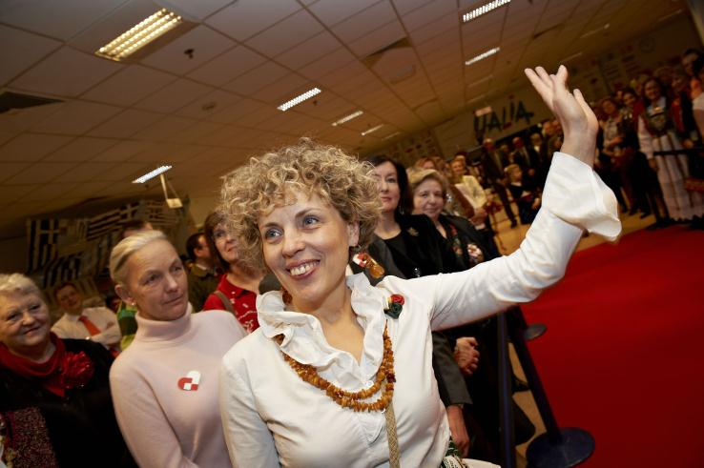
Roll Call of Participating Nations
Honorary President, Lady Jan Harper, and Honorary Vice-President, Ms. Kati Schmidt will alternate calling the role of participating nations and clubs, who will then take a step forward, answer Present in their own language, and wave their flag.
Please refrain from waving your flag until YOUR country is called to keep focus on one country at a time.

Slide 61
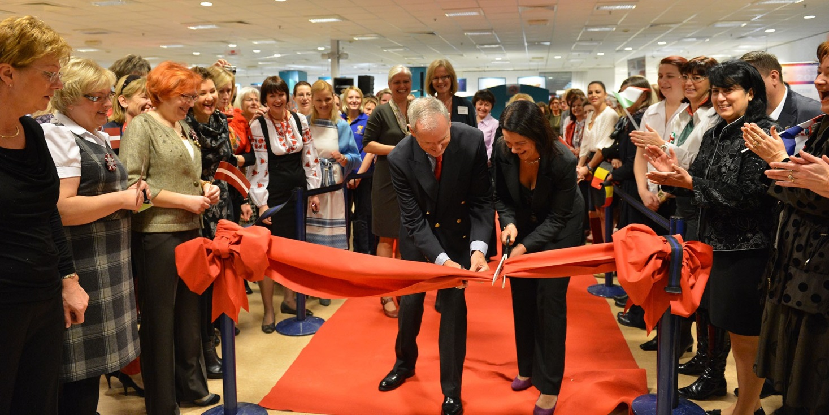
Ribbon Cutting
After the Ribbon Cutting the Bazaar is declared
officially opened.
10:15 International Restaurant preview
11:15 National Stands preview

Slide 62
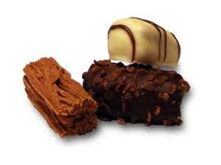


Coffee Break
15 min
Thank you

Slide 63
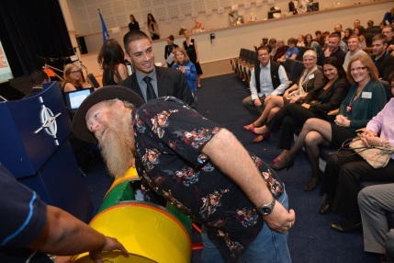
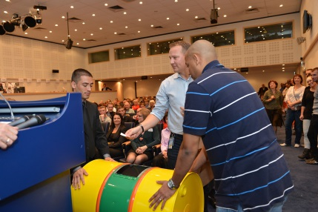
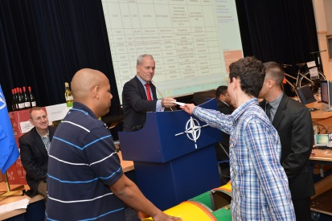
Tombola Instructions
Carla Bucalossi Quatrini - Tombola Coordinator
  Final instructions
    Ticket Sales Schedule
    Turning in tickets
    Saturday & Sunday Instructions
    What to do with Prizes + stubs of sold tickets and unsold tickets
    Members drawing and Tombola Winners
    Picking up Prizes

Slide 64
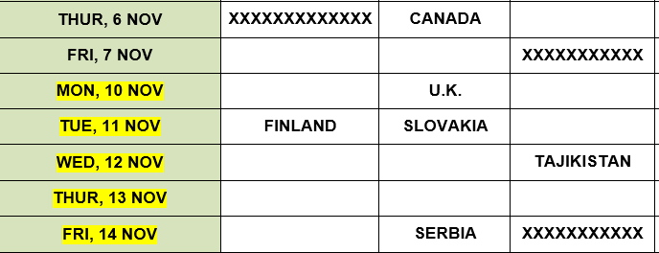
Ticket Sales Schedule 2014
Updated schedule always available in ‘Members Only’ area on NCB Website

Slide 65
Turning in Your Tombola Tickets
Date: Saturday, November 15th
Time: 1130-1330
Location: Luns Theater
BRING:
Unsold tickets
Ticket stubs of sold tickets
Tombola Ticket allocation/Accountability Sheet
No Money

Slide 66
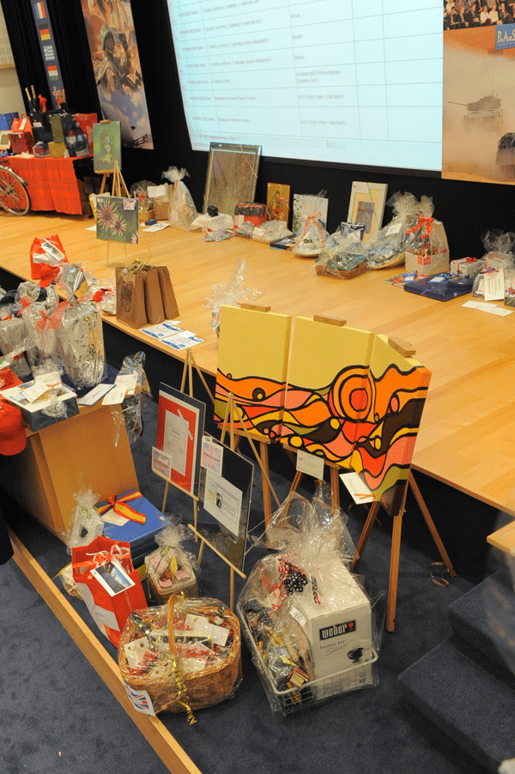
BRING
Prizes to Luns Theatre
on Saturday from 0900-1100
Unsold tickets, Ticket Stubs of sold tickets + Accountability Sheet from 1100-1300

Slide 67
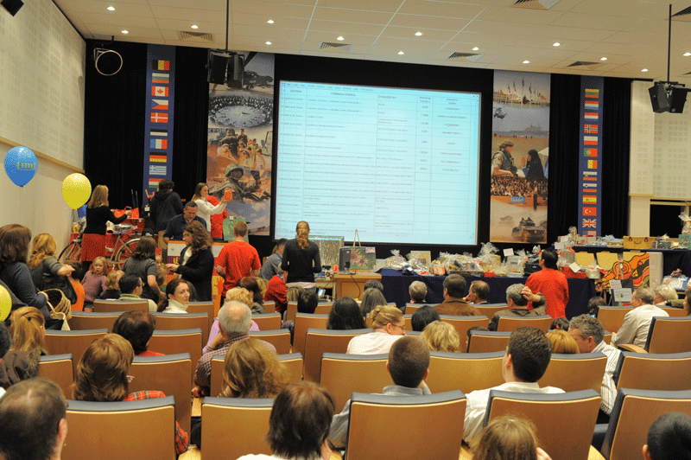
Tombola Instructions
SATURDAY
TURNING IN PRIZES
Turn in prizes from 0900-1100 along back wall of Luns Theatre.
All prizes need to be wrapped (preferably in cellophane) and ready for display.
TURNING IN TICKETS
Bring unsold and stubs of sold tickets AND Accountability Sheet to the front of the Luns Theatre from 1130-1330

Slide 68
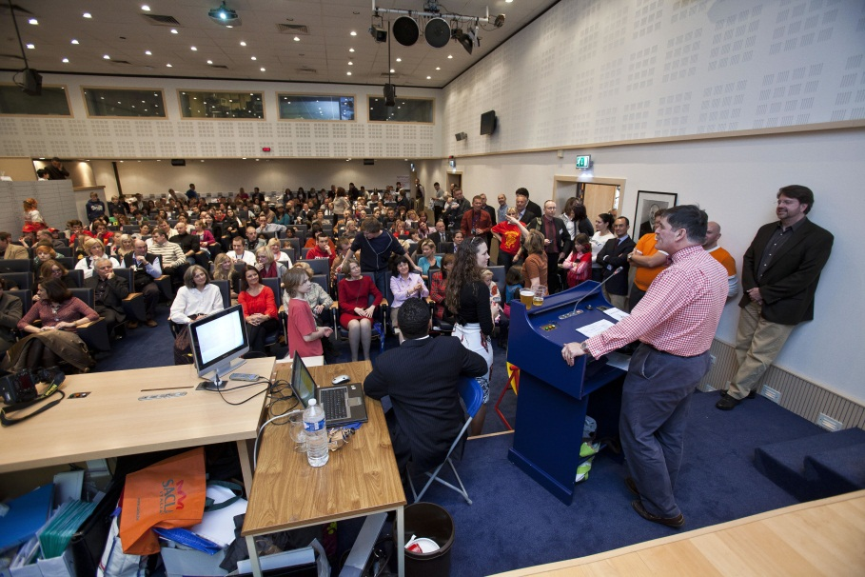
0
Tombola Instructions
SUNDAY
TICKET SALES: Tombola Tickets available for sale at NCB Info Desk in front of the Luns Theatre
from 9:00am – 13:00 (1:00pm)
BEGINS: Tombola begins at 14:00 (2:00pm)
ENDS: Tombola ends at 16:00 (4:00pm)
WINNERS: Winning ticket numbers will be displayed on the big screen

Slide 69
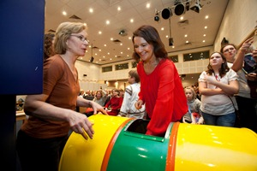
IMPORTANT
Members Draw
Tombola Winners
Drawing begins at 14:00 (2.00pm)
Every nation can send one or more representatives to draw their prizes.
We will go in alphabetical order. If you are not present when your nation is called, we will call someone from the audience.
The Dignitaries will be the first group to draw.

Slide 70
PICK UP: Tombola Prizes will be available for pick up during the Bazaar.
LIST OF WINNERS: Winning numbers will be posted on Minerva and on Posters beginning Tuesday, November 18th
AFTER BAZAAR: Tombola Winner Prizes available at NATO HQ during After Sale.
LAST DAY TO PICK UP PRIZES: December 5
PICKING UP PRIZES

Slide 71

Tombola Accountability Form
14001
14100
100
National Representative
7
0
93
232,50
Your Name Here
Quantity returned, lost, and sold
Amount (in Euros) turned in
100

Slide 72



International Restaurant 2014
Christina Arvanitaki - Restaurant Coordinator restaurant@natocharitybazaar.org
Reminders

Slide 73
International Restaurant 2014
Christina Arvanitaki – Int. Restaurant Coordinator
Nations selling on Saturday
Belgium
Croatia
Czech Republic
Denmark
Estonia
Germany
Greece
Italy
Latvia
10. Lithuania
11. The Netherlands
12. Norway
13. Portugal
14. Slovakia
15. Spain
16. Turkey
17. United Kingdom

Slide 74

Restaurant Floor Plan 2014
Christina Arvanitaki - International Restaurant Coordinator
Table Size: 70 x 80 cm
4-5 tables per country
Remember to bring flags from your country for display on the dining tables!

Slide 75
BAZAAR SETUP IN RESTAURANT ON SATURDAY
Set Up: Begins at 8:00h
Decorating the Tables in the Dining Area
Placing your nation’s Name Plate
Checking Electricity Outlets
17 nations selling food and drink on Saturday
Remember to clean up!
Shop, eat and enjoy the day!
All personnel in the kitchen are MUST have a kitchen sticker
Closing on Saturday: 13:00h
Be sure you leave everything
clean and ready for Sunday ☺

Slide 76



When you arrive on Saturday
You will have:
Fridges/Shelves labeled with flags
Your Country Name Plates
Two (2) white garbage bags
Clean Up Check List + Floor Plan

Slide 77


Countries with restaurant stands WITHOUT teen helpers may sign up for a one-hour shift to take out trash or work in the dish wash station
Teen Helpers will be clearing the tables

Slide 78




How it looks during ‘Rush Hour’

Slide 79
International Restaurant 2014
Cristina Arvanitaki – Int. Restaurant Coordinator
VOLUNTEERED TEEN HELPER’s
1. Åsa Rogneflåten Norway
2. Sara Mediå Norway
3. Edgars Bucens Latvia
4. Gorrit- Cor Lootsma Netherlands
5. Sophie Summer Beech UK
6. Isabel Emma Cunningham UK
7. Panagiotis Madouros Greece
8. Nikolaos Akrivos Greece
9. Konstandinos Tsirigotakis Greece
10. Alexandros Madouros Greece
11. Maria Mavromanolaki Greece
12. Anastasia Giannidaki Greece
13. Politimi Papadimitropoulou Greece
14. Sofia Dionysopoulou Greece
15. Vasiliki Akrivou Greece
16. Adamantia Aimilia Dimitrakopoulou Greece
17. Natalia Dimitrakopoulou Greece
18. Daniels Raugevicus Latvia
Thank you Greece!

Slide 80


Slide 81
Restaurant Stand Clean-Up Checklist
Cleaned cooking area
Returned all borrowed cooking utensils
Cleared and cleaned tables used for your stand with wet towels or sponges.
Cleared and cleaned restaurant tables with wet towels or sponges.

Slide 82
Restaurant Stand Clean-Up Checklist
Took all garbage to designated garbage dumpsters
Swept floor around your tables (please bring a broom and dustpan).
Waited for sign off below from NCB Board Member before leaving for the day.
Returned Name Plates to NCB Information Desk in front of the Luns theatre

Slide 83

CHILDREN IN THE KITCHEN AREA
For security reasons children under the age of sixteen (16) years are NOT allowed in the kitchen area!
NO EXCEPTIONS !

Slide 84

Donating Leftover Food
Pick Up at 16:30h

Slide 85

FINAL INTERNATIONAL RESTAURANT
COORDINATION MEETING
13 November 2014 at 15.00h in NATO Self Service Restaurant with Chef

Slide 86





Sponsors & Events
Dionysia Leolei, Sponsors & Event Coordinator
Sponsor Stands NCB 2014

Slide 87
Sponsors & Events
Dionysia Leolei, Sponsors & Event Coordinator

Slide 88

Sponsors & Events
Dionysia Leolei, Sponsors & Event Coordinator
Sponsor Stand Nr. 1
Press Hall
Just in front of ING

Slide 89

Sponsors & Events
Dionysia Leolei, Sponsors & Event Coordinator
Sponsor Stand Nr. 2
Next to Finland
Room behind the stage

Slide 90
Sponsors & Events
Dionysia Leolei, Sponsors & Event Coordinator
Sponsor Stand Nr. 4
Next to Italy
Opposite to the stage

Slide 91
Sponsors & Events
Dionysia Leolei, Sponsors & Event Coordinator
Sponsor Stand Nr. 6
Next to Artist Corner
Corridor between press hall and stage

Slide 92
Sponsors & Events
Dionysia Leolei, Sponsors & Event Coordinator
Sponsor Stand Nr. 5
Next to Sweden
and NATO Staff Center

Slide 93

Sponsors & Events
Dionysia Leolei, Sponsors & Event Coordinator
Sponsor Stand Nr. 3
ING bank next to Netherlands

Slide 94

Sponsors & Events
Dionysia Leolei, Sponsors & Event Coordinator
We our SPONSORS
Don’t forget to
visit their stands!

Slide 95




Donation Ceremony
Jimmie Bradshaw – President
27 January 2015
9h30-12h30
NATO Staff Center, Banquet Room
Who may attend:
National Rep. & Assistant National Rep.

Slide 96


Slide 97
Any other Business
Jimmie Bradshaw - President
New Board Members 2015
  President
  Vice-President
  Treasurer*
  Secretary
  Guest Access Coordinator
  Sponsors & Events
  Tombola Team
  Charity Team

Slide 98

Closing
Jimmie Bradshaw - President
Upcoming Dates
    13 November
        Final Restaurant Meeting with Chef (Kitchen)
    27 January 2015
        Donation Ceremony - (NATO Staff Centre Banquet Room)
    10 February 2015
        First 2015 Bake Sale!
Please return voting cards and folders

